Slide 1

MGMT Final Presentation
By: Names

Slide 2
Our Company and Business Strategy
Imagine a set of ear tips that improve comfort and sound quality in addition to offering the ideal fit. Hours of comfortable listening are guaranteed by the tight, noise-isolating seal created by the excellent silicone we use. Our ear tips provide exceptional durability and an ergonomic fit that conforms to your individual ear shape, whether you're wearing them for your everyday commute, exercise, work or gaming sessions. They are the perfect addition to any earphone since comfort, quality, and fit should always come first. Our products come in a variety of sizes that are customized just for you.
Sound Fit aims to provide custom ear tips for those looking to not sacrifice quality at a fraction of the price for our customers.

Slide 3
Business Strategy: Website
https://mgmt607group2.wixsite.com/sound-fit

Slide 4
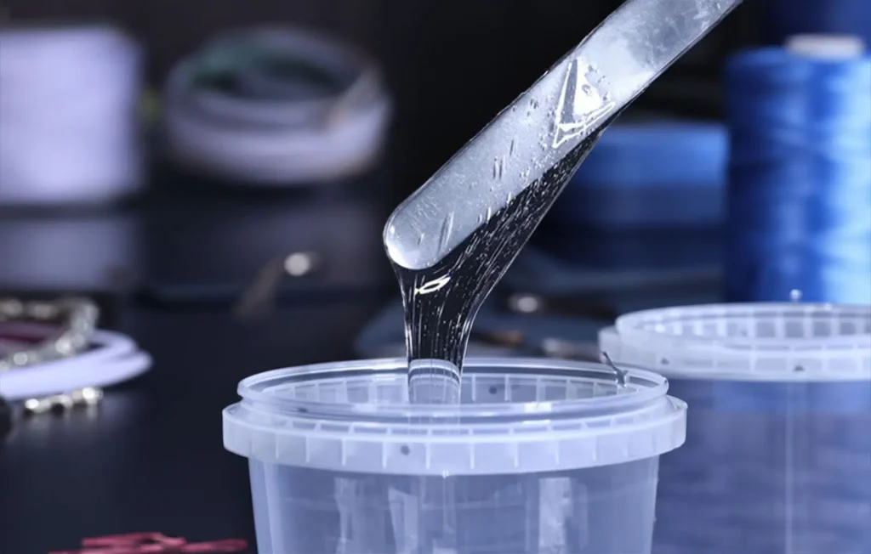


Business Strategy: Sourcing
Tested Multiple Prototypes with Various Raw Materials
  Medical-Grade Silicone (High-Density Blend)
  Memory Foam with a Silicone Coating
  Thermoplastic Elastomers (TPE) with Custom Modulus
  Liquid Silicone Rubber (LSR) with Additive Fillers
  Polyurethane Elastomer
Diversify Risks | Multiple Suppliers | +/-
  Alibaba – China, Thailand, Vietnam, India, South Africa
  Dow Chemical Company – CONUS, Americas, Europe
  Stockwell Elastomerics – Philadelphia

Slide 5
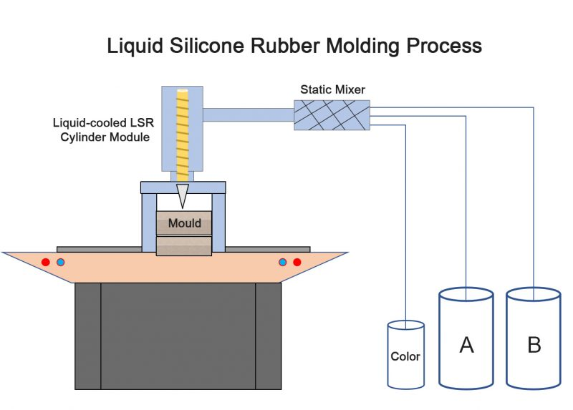
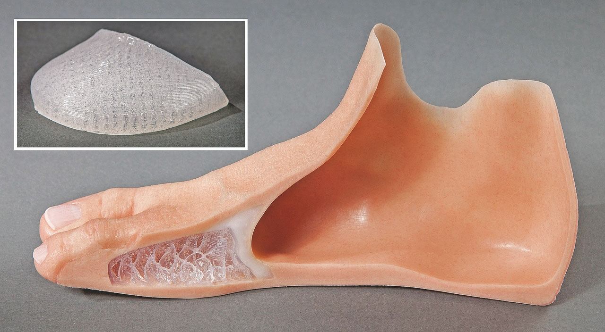
Business Strategy: Manufacturing
Outsource Manufacturing (Molds & 3D Printing)
  Existing overlap with some raw material suppliers.
  Leverage skills and experience of specialized manufacturers.
  Able to diversify risk amongst multiple manufacturers.
    Multi-origin shipping. Send data/scans of ears to manufacturer nearest to customer.
  No equipment maintenance concerns.
  Less upfront costs, able to allocate funds to R&D and Marketing
  Less control over quality and due dates
  Higher per unit costs
  Intellectual Property concerns

Slide 6

Business Strategy: Distribution
We want to collab with reputable producers to ensure constant quality by producing ear tips in large quantities.
Respect national health rules regarding medical-grade eartips. We also want to ensure we have different languages available.

Slide 7


Business Strategy: Logistics
Direct-to-consumer (D2C) model via the website for global accessibility.
Partner with reliable shipping providers for fast and affordable delivery.
Establish tracking systems for transparent order updates.

Slide 8
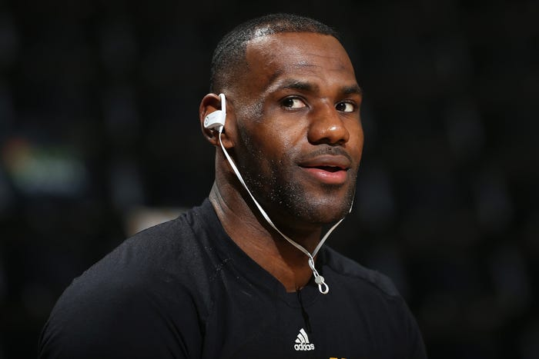
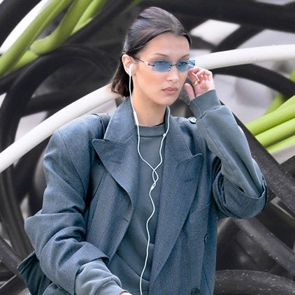




Business Strategy: Marketing and Partnerships
Marketing
  Recognizable Branding
  Advertisements on social media platform and creation of accounts (Instagram, TikTok, Facebook)
Partnerships
  Athletes
  Celebrities
  Podcasters and Musicians

Slide 9
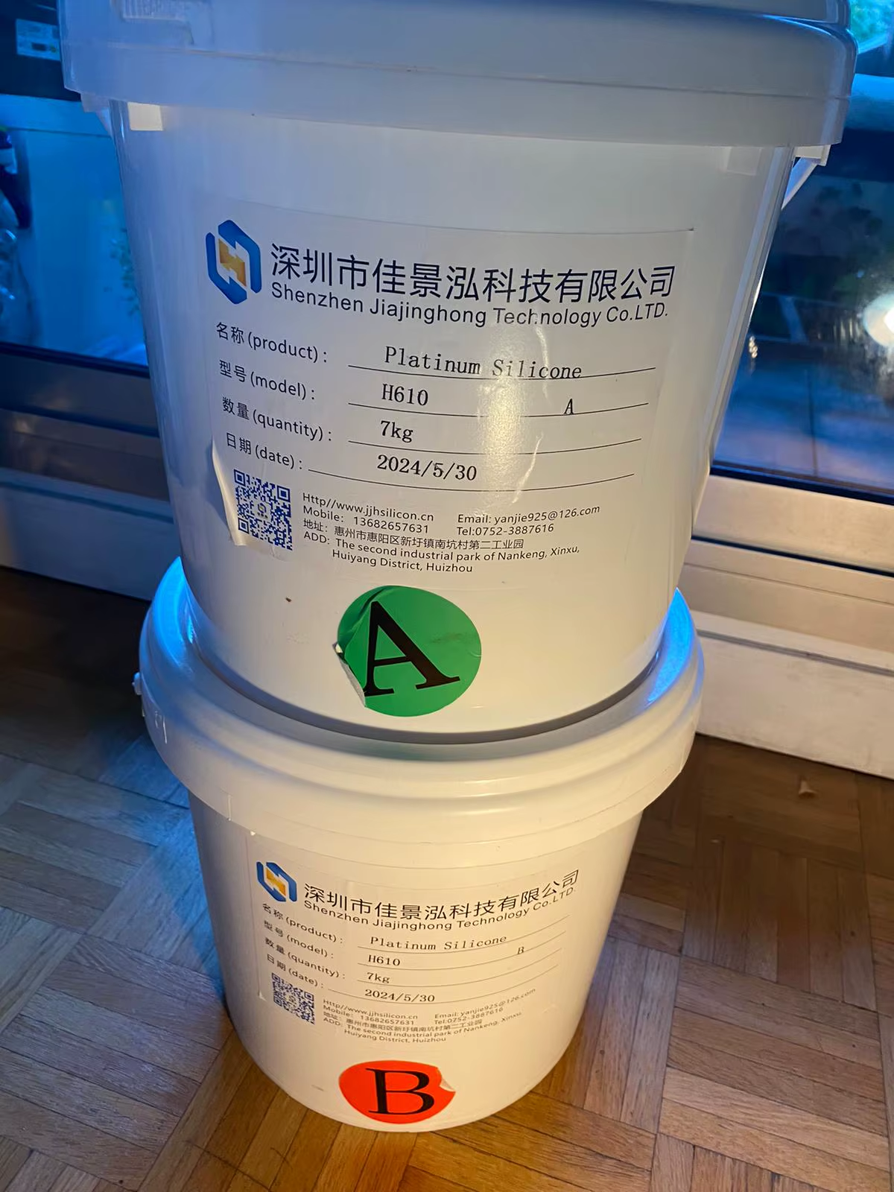
Business Strategy: Costs
Initial Costs
Research & Development
  Proprietary ear-scanning technology and CAD modeling software.
  Material tests (incl. licensing and compliance with FDA)
Setup fees for file/order integration with manufacturing partners.
Intellectual Property Protection
  Patents for scanning technology, proprietary material blend & processes
Variable Costs
Materials
  $0.50/kilo of uncolored LSR, + additives + color ≈ $1/kilo ≈ 35 pairs of ear tips [70 units total] = $0.03 / pair of ear tips
  If shipped from supplier to US manufacturer, $19/kilo ≈ 35 pairs of ear tips [70 units total] = $0.54 / pair of ear tips
Manufacturing ($2.60 - $5.00 per unit) = $5.20 - $10.00 / pair of ear tips

Slide 10
Business Strategy: Profitability
Sale Price = $99.99
COGS = *$10.54 / per pair of ear tips
R&D ≈ $51,272
  $50,000 photogrammetry software
  $106.02/mo, $1272/year website & manufacturer integration (additional $25,000 cushion)
Advertising ≈ $100,000
Intellectual Property ≈ $20,000
Gross profit = $89.45
W/ Advertising
Break Even Point = 1915 pairs
= $191,480.85 in sales
W/O Advertising
Break Even Point = 797 pairs = $79,692.03 in sales

Slide 11

Business Strategy: Returns
Implement an exchange/return policy
  Reduce purchase hesitation
  Increase customer satisfaction and loyalty
30 day exchange/return policy
  Customers may exchange or return our products no questions asked
  Shipping return label will be available

Slide 12
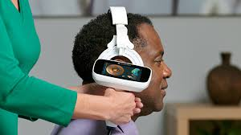
Future Implementations
Expansive Customer Profiles
Login info
Lidar Scans
3D scanning to map out ear for precise fit
Profile
Order history/check status
Lidar Scans becoming easier to access
Returns/exchanges

Slide 13



Future Implementations (Cont.)
Updated Facilities
  Regional Facilities
  Dedicated Production Hubs
Creation of a Mobile App
  Mobile app will allow for accurate ear scans
  Augmented Reality visuals of design and colors
  Incorporate Push Notifications for Order Updates
Mold Kits
  At-Home Mold Kits
  Incentives for Mold Kit usage

Slide 14
Thanks for Watching :)

