Slide 1
ENHANCING STUDENT LEARNING EXPERIENCE THROUGH ACTIVITY-BASED LEARNING (WEB PROJECT DEVELOPMENT)
James W. Miller
K.R. Vishwanath

Slide 2
CONFUCIUS:
I hear and I forget.
I see and I remember.
I do and I understand.
Lecture only
HEAR AND FORGET
Lecture +Case Study
SEE / HEAR
REMEMBER (?) MAYBE
Lecture + Hands On Project – Web Development
GET HANDS DIRTY
EXPERIENCE
UNDERSTAMD

Slide 3
TRADITIONAL LEARNING : I SEE and I FORGET
Designed, controlled and executed by
Teachers
Mostly one way communication
Highly structured and geared towards
Teacher’s and the Institution’s goals
Ref: Keys, A.C. (2003). Using Group Projects In MIS : Strategies for Instruction and Management.

Slide 4
Learning takes place in many formats within a spectrum
Objectivist Model
Information Transfer
Teacher Student
Frame of reference set
by Teacher.
Student learning is
Individual and isolated.
Ref: Keys, C.A
Constructivist Model
Information Transfer
within the learning
Community.
Frame of reference is
experiential.
Student learning is
group based and adaptive.

Slide 5


Slide 6
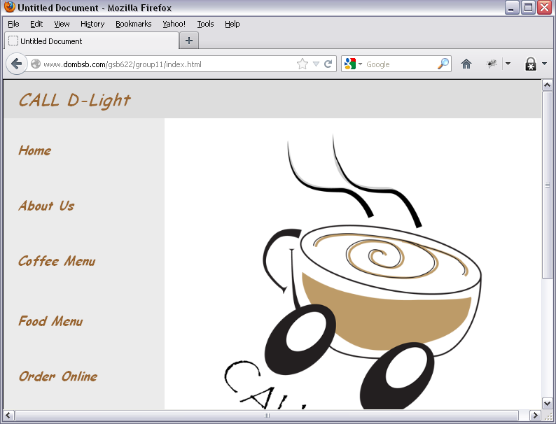

Slide 7


Slide 8
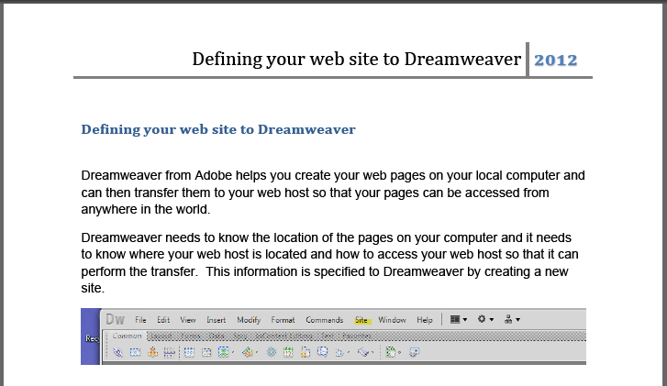

Slide 9
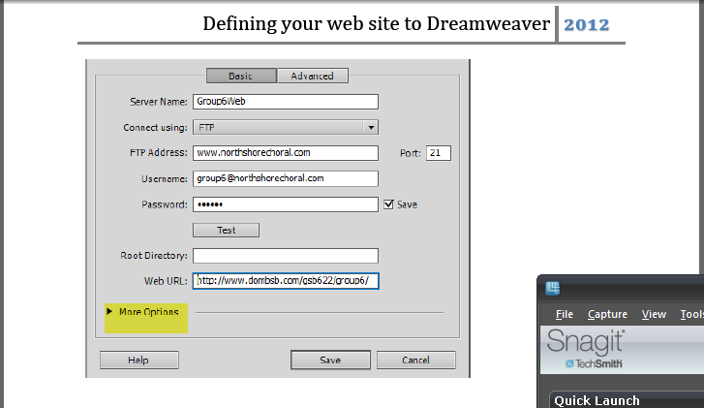

Slide 10


Slide 11
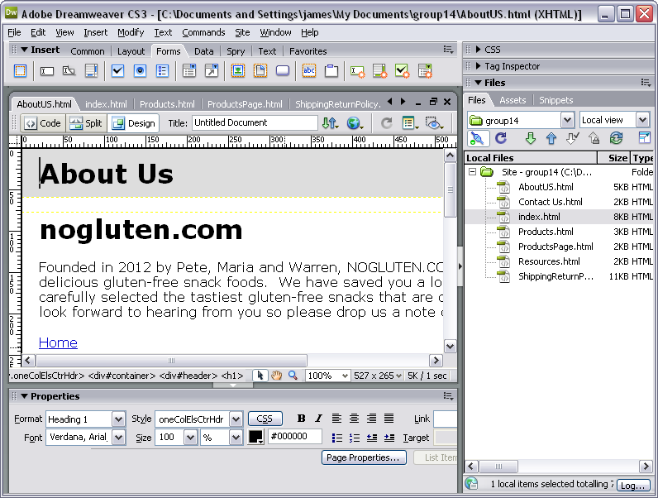

Slide 12
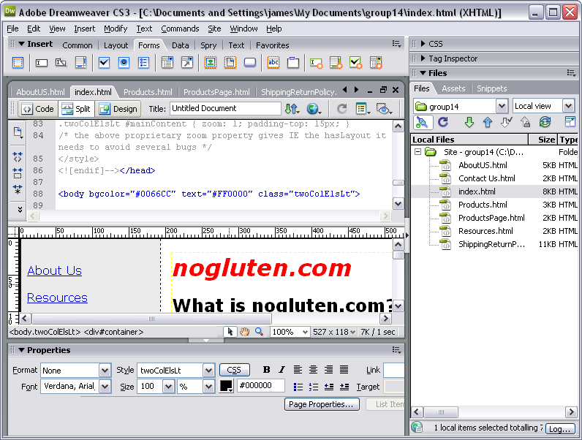

Slide 13
The Road Ahead – Plans For The Future
Transform the classroom into a dynamic learning community
Have students experience MIS / Technology that is contemporaneous
Student heavily involved in learning process
Less emphasis on lectures more on actually doing stuff
Student’s understanding exponentially improves.

